Slide 1
DERIVATIVES
CHAPTER 3
The Hennessey Venom GT can go from 0 to 200 mph in 14.51 seconds

Slide 2
Why study derivatives?
How one quantity changes in relation to another quantity?
Derivative = Rates of change: occur in all the sciences.
Velocity, density, current, power, and temperature gradient in physics;
rate of reaction in chemistry;
rate of growth and blood velocity in biology;
marginal cost and marginal proﬁt in economics;
rate of heat ﬂow in geology;
rate of improvement of performance in psychology;
rate of spread of a rumor in sociology (analyzing innovations or fads or fashions)
— these are all special cases of a single mathematical concept, the derivative.
➔ The power of mathematics lies in its abstractness.

Slide 3
OUR GOAL:
From real world problems to new concept-derivatives.
Need to calculate derivatives ⬅ Need formulas to compute easily derivatives of functions.
More problems can be solved using the concept of derivative.
A Single Idea, Many Interpretations

Slide 4
From problems to new concept
Tangent line problem
Instantaneous velocity problem
Instantaneous rate of change

Slide 5
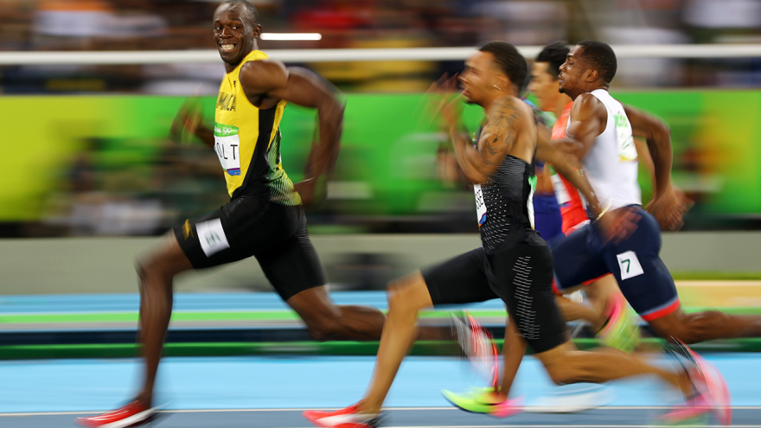
Velocity problem
Before calculus With calculus
Average velocity instantaneous velocity
Usain Bolt in 2009:
100-meter per 9.58-second
Average speed: 10.44 m/s
Top speed: 12.27 metres per second
How to compute?

Slide 6
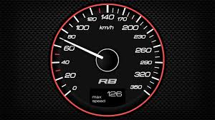


Definition of derivative
How to find instantaneous velocity at a?
Starting point
a
a+h
f(a)
f(a+h)
Rate of change = $\frac{change in displacement}{change in time}$

Slide 7
is called the derivative of f at a.
Read: “The derivative of f with respect to x is …”
f’(x): “f prime x”

Slide 8
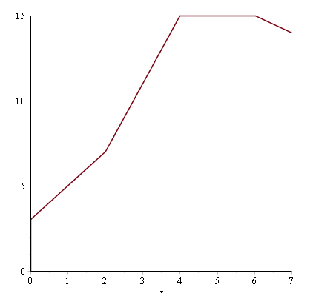
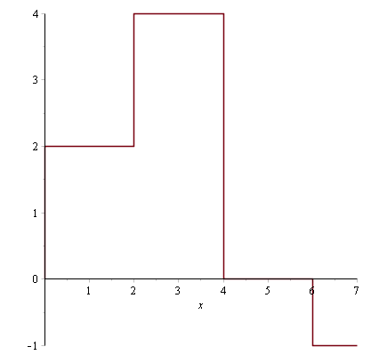
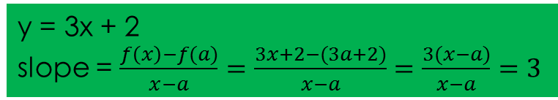
Slope of a line
f(x)
m = slope of the line y = mx + b
f(x) – f(a)
x-a
f’(x)
y = 3x + 2
slope = $\frac{f\left(x\right)−f(a)}{x−a}=\frac{3x+2−(3a+2)}{x−a}=\frac{3(x−a)}{x−a}=3$

Slide 9
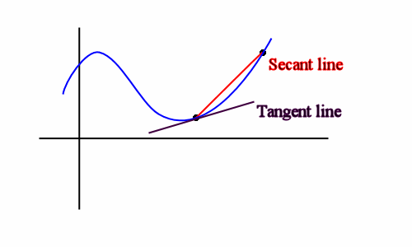
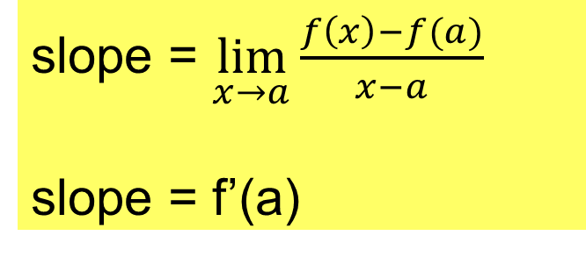
Slope of a curve - Tangent line
How to find the slope of a curve y = f(x) (not a line)?
f’(a) = slope of tangent line to the curve at x = a
Slope of the curve = slope of the tangent line at x = a.
slope = $\lim_{x→a}{\frac{f\left(x\right)−f(a)}{x−a}}$
slope = f’(a)
a
x
Notes:
Use Maple to illustrate.

Slide 10
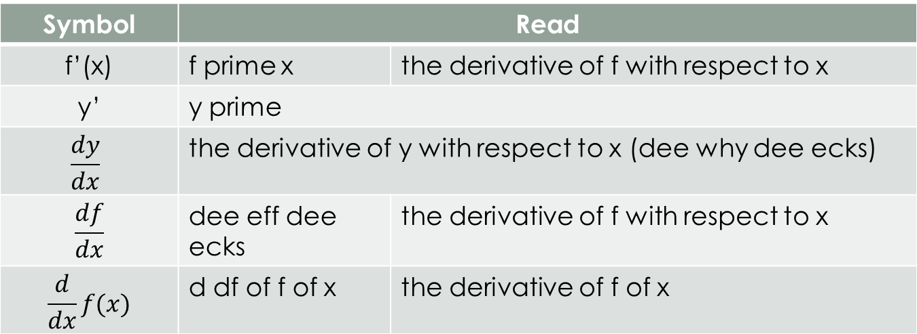
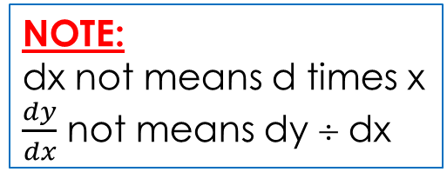
Many symbols and many ways to read
Symbol | Read
f’(x) | f prime x | the derivative of f with respect to x
y’ | y prime
$$\frac{dy}{dx}$$ | the derivative of y with respect to x (dee why dee ecks)
$$\frac{df}{dx}$$ | dee eff dee ecks | the derivative of f with respect to x
$$\frac{d}{dx}f(x)$$ | d df of f of x | the derivative of f of x
NOTE:
dx not means d times x
$\frac{dy}{dx}$ not means dy ÷ dx

Slide 11
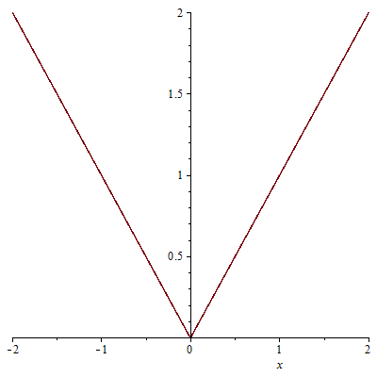
differentiable
f’(a) exists ➔ f is differentiable at a
Differentiable at a ➔ continuous at a (ALWAYS TRUE)
Continuous at a ➔ differentiable ? (NOT ALWAYS TRUE)
FOR EXAMPLE.
y = |x|is continuous at x = 0 but not differentiable at x = 0.

Slide 12
Review
Derivative = (instantaneous) rate of change (= rate)
Slope of tangent line at a = f’(a)
Velocity of particle at t = v(t) = s’(t), where s(t) is the position function.
Acceleration of particle at t = a(t) = v’(t)
Differentiable at x = a ➔ continuous at x = a

Slide 13

Calculate derivative by definition
Example 1.
Find y’(2) if
$$y=f(x)= x^{2}$$
$$f^{′}(2)=\lim_{h→0}{\frac{f\left(2+h\right)−f\left(2\right)}{h}}$$
$$=\lim_{h→0}{\frac{\left(2+h\right)2−22}{h}}$$
$$=\lim_{h→0}{\frac{4+4h+h2−22}{h}}$$
$$=\lim_{h→0}{(4+h)}=4$$
0

Slide 14
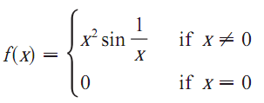
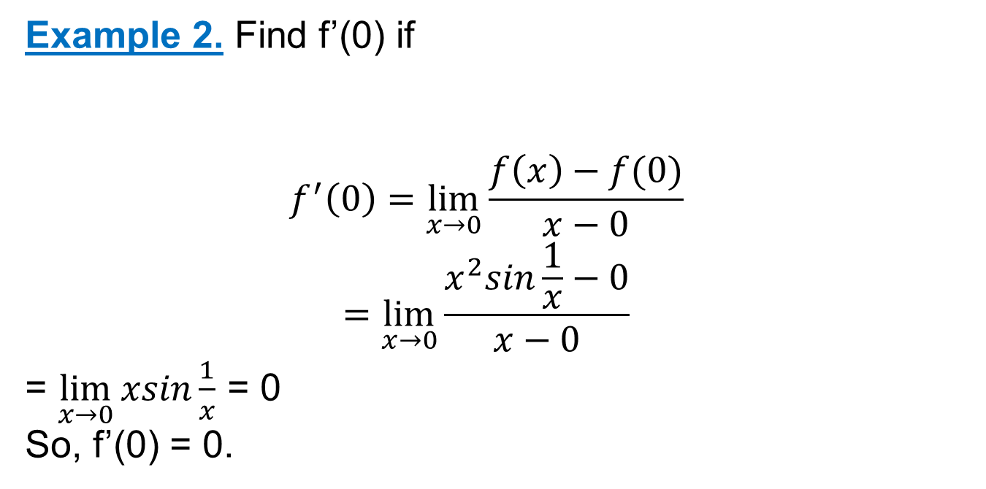
Calculate derivative by definition
Example 2. Find f’(0) if
$$f^{′}\left(0\right)=\lim_{x→0}{\frac{f\left(x\right)−f(0)}{x−0}}$$
$$=\lim_{x→0}{\frac{x^{2}sin\frac{1}{x}−0}{x−0}}$$
= $\lim_{x→0}{xsin\frac{1}{x}}$ = 0
So, f’(0) = 0.
For x > 0 (similarly for x < 0)
-x ≤ xsin(1/x) ≤ x
0

Slide 15
DO YOURSELF
f(x) = 3x. Find f’(2) using definition of derivative

Slide 16
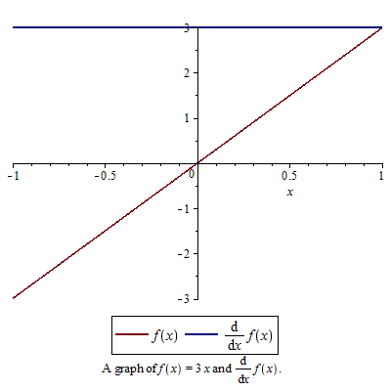
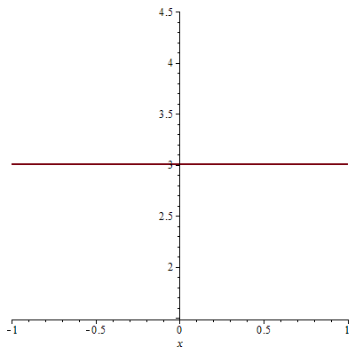
Formulas – CHECK YOURSELF
(cx)’ = c
(c)’ = 0
f(x)=3

Slide 17
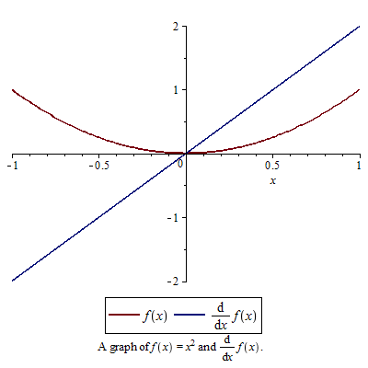

Formulas
f(x) = x²
f’(a) = $\lim_{x→a}{\frac{f\left(x\right)−f(a)}{x−a}}=\lim_{x→a}{\frac{x^{2}−a^{2}}{x−a}}$
$$=\lim_{x→a}\frac{(x−a)(x+a)}{x−a}$$
= $\lim_{x→a}$(x+a) = 2a
So, f’(x) = 2x
(x²)’ = 2x

Slide 18
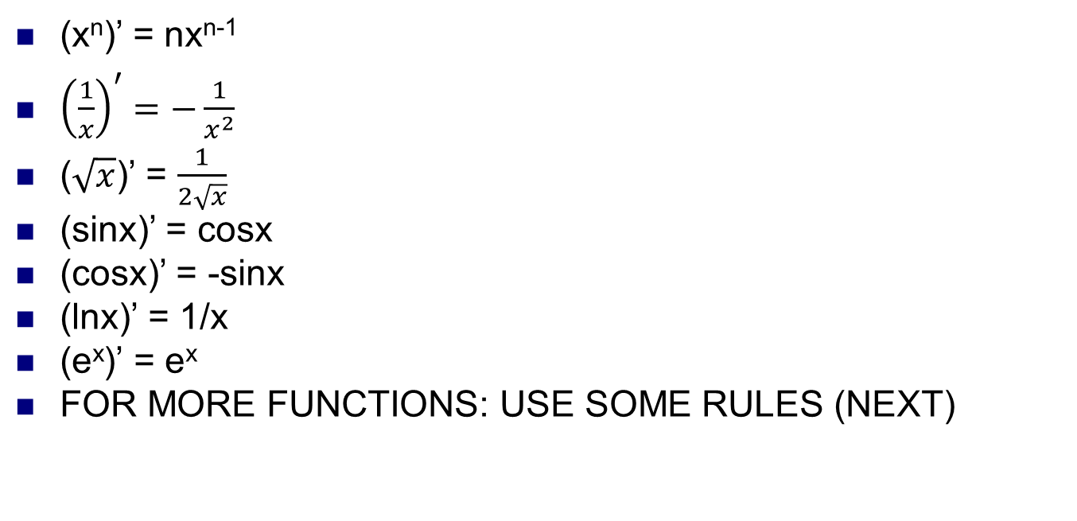
formulas
(x^{n})’ = nx^{n-1}
${\left(\frac{1}{x}\right)}^{′}=−\frac{1}{x^{2}}$
($\sqrt{x}$)’ = $\frac{1}{2\sqrt{x}}$
(sinx)’ = cosx
(cosx)’ = -sinx
(lnx)’ = 1/x
(e^{x})’ = e^{x}
FOR MORE FUNCTIONS: USE SOME RULES (NEXT)
TRY TO REMEMBER!

Slide 19
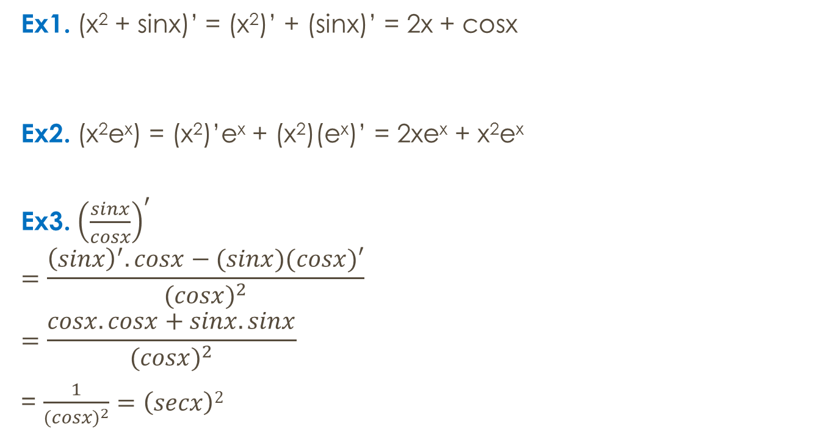

RULES
(f + g)’ = f’ + g’
Ex1. (x² + sinx)’ = (x²)’ + (sinx)’ = 2x + cosx
Ex2. (x²e^{x}) = (x²)’e^{x} + (x²)(e^{x})’ = 2xe^{x} + x²e^{x}
Ex3. ${\left(\frac{sinx}{cosx}\right)}^{′}$
$$=\frac{{\left(sinx\right)}^{′}.cosx−(sinx)(cosx)′}{{(cosx)}^{2}}$$
$$=\frac{cosx.cosx+sinx.sinx}{{(cosx)}^{2}}$$
= $\frac{1}{{(cosx)}^{2}}=\left(secx\right)2$
(f.g)’ = f’g + g’f
$${\left(\frac{f}{g}\right)}^{′}=\frac{f^{′}g−g^{′}f}{g^{2}}$$

Slide 20
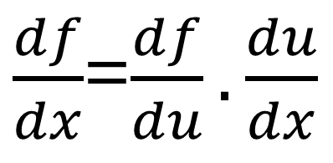

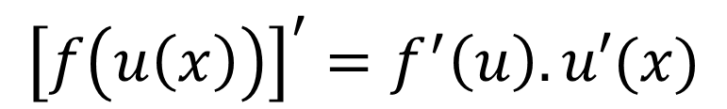
The chain rule
f(u(x))
Example .
[sin(x²)]’= cos(x²).2x
f
u(x)
f’
u(x)
u’(x)
$\frac{df}{dx}$=$\frac{df}{du}.\frac{du}{dx}$
$${\left[f\left(u\left(x\right)\right)\right]}^{′}=f^{′}\left(u\right).u′(x)$$
$${\left[(f□u)(x)\right]}^{′}=f^{′}\left(u\right).u′(x)$$

Slide 21
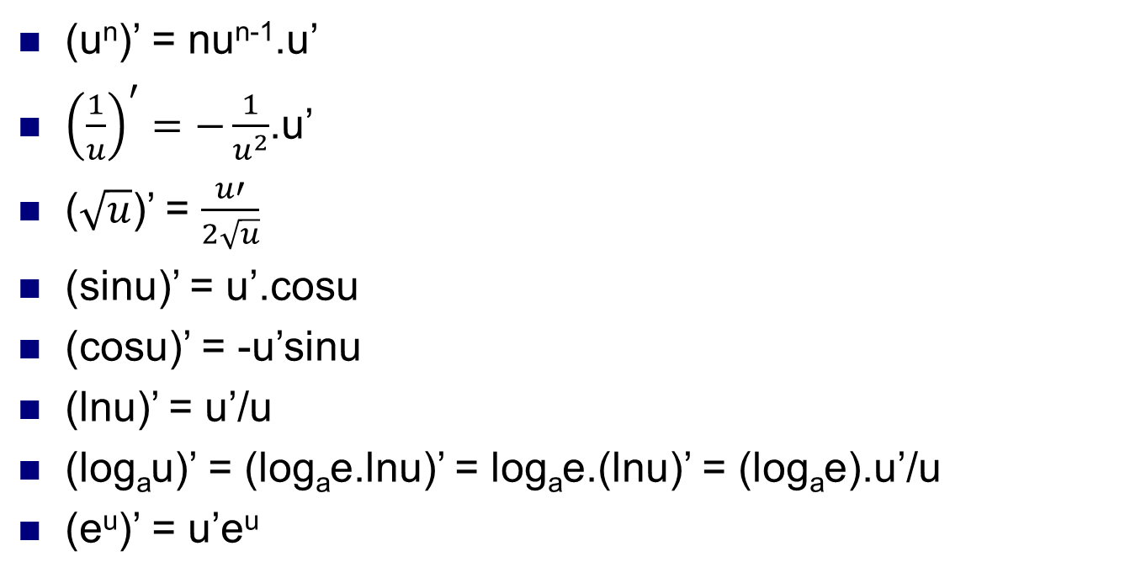
Formulas (from chain rule)
(u^{n})’ = nu^{n-1}.u’
${\left(\frac{1}{u}\right)}^{′}=−\frac{1}{u^{2}}$.u’
($\sqrt{u}$)’ = $\frac{u′}{2\sqrt{u}}$
(sinu)’ = u’.cosu
(cosu)’ = -u’sinu
(lnu)’ = u’/u
(log_{a}u)’ = (log_{a}e.lnu)’ = log_{a}e.(lnu)’ = (log_{a}e).u’/u
(e^{u})’ = u’e^{u}
TRY TO REMEMBER AND USE!

Slide 22
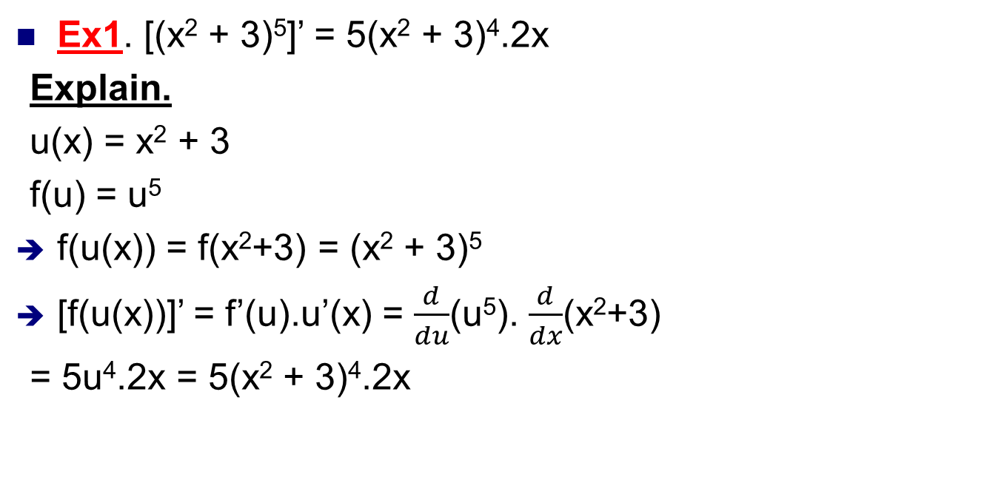
The chain rule-examples
(u^{n})’ = nu^{n-1}.u’
Ex1. [(x² + 3)⁵]’ = 5(x² + 3)⁴.2x
Explain.
u(x) = x² + 3
f(u) = u⁵
f(u(x)) = f(x²+3) = (x² + 3)⁵
[f(u(x))]’ = f’(u).u’(x) = $\frac{d}{du}$(u⁵). $\frac{d}{dx}$(x²+3)
= 5u⁴.2x = 5(x² + 3)⁴.2x
f(u(x))

Slide 23

The chain rule - examples
Solution.
F(x) = f(g(x)) // F = f□g
➔ F’(x) = f’(g(x)).g’(x)
F’(5) = f’(g(5)).g’(5)
= f’(-2).6
= 4.6 = 24

Slide 24
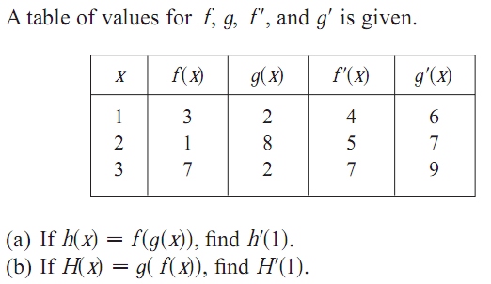
The chain rule - examples
h’(x) = f’(g(x)).g’(x)
h’(1) = f’(g(1)).g’(1)
h’(1) = f’(2).6 = 5.6 = 30
b) DO YOURSELF
H’(x) = g’(f(x)).f’(x)
➔ H’(1) = g’(f(1)).f’(1) = g’(3).4 = 9.4 = 36

Slide 25
The chain rule-examples
Given the table below.
Let h(x) = f(f(x)) and g(x) = f(x²). Find h’(2) and g’(2).
Solution.
h’(x) = f’(f(x)).f’(x)
h’(2) = f’(f(2)).f’(2)
h’(2) = f’(1).f’(2) = 20
DO YOURSELF: g’(2)=?
g’(x) = f’(x²).(x²)’
= f’(x²).(2x)
➔ g’(2) = f’(2²).(2.2) = f’(4).4 = 2.4 = 8
x | f(x) | f’(x)
1 | 3 | 4
2 | 1 | 5
3 | 7 | 7
4 | 5 | 2

Slide 26
True or false?
[f(g(x))]’ = f’(x).g’(x)
[f(g(x))]’ = f’(g(x))
[f(g(x))]’ = f’(g(x)).g’(x)

Slide 27

Implicit function
DO YOURSELF:
Given
a) y² + x³ – 3x + y – 7 = 0
b) x² + 2xt + t – t³ – 4 = 0
Find y’(x)?
Find x’(t)? x’(t = 0 and x > 0)
y = y(x) defined by
x + cosy + y = 0
How to find y’(x)?
Solution.
x + cosy + y = 0
(x + cosy + y)’ = 0
(x)’ + (cosy)’ + y’(x) = 0
1 –sin(y(x)).y’(x) + y’(x) = 0
1 + [-sin(y) + 1].y’(x) = 0
y’(x) = $\frac{−1}{(1 −\sin\left(y\right))}=\frac{1}{(siny −1)}$
How to find y’(x) at the point (x=-1, y = 0)?
y’(x=-1 and y = 0) = 1/(-1) = -1

Slide 28
applications
Tangent line, normal line and Linear approximation
Rate of change: Velocity, acceleration
Related rates
Approximation by differentials

Slide 29
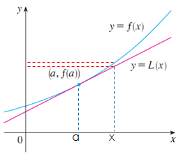
tangent line to the curve and linear approximation
Given the curve y = f(x)
Tangent line at the point (a, f(a))
y = f’(a)(x – a) + f(a) // slope = f’(a)
Approximation problems.
f(x): difficult to calculate ➔ approximate this value by y = f’(a)(x – a) + f(a) = L(x) // x is near x₀
f(x) ≈ L(x) when x is near a
Linear approximation
Tangent line approximation
Linearization of f at a.

Slide 30
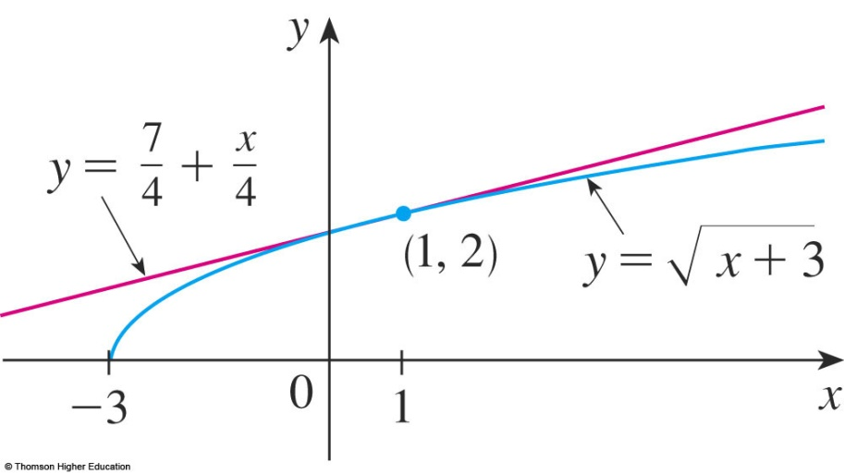
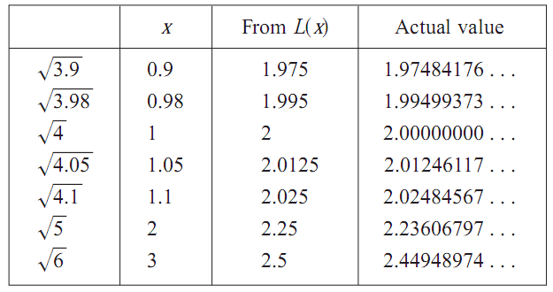

Linearization. example
Find the linearization of the function
$f\left(x\right)=\sqrt{x+3}$at a = 1
and use it to approximate the numbers $\sqrt{3.98}$and $\sqrt{4.05}$.
Solution.
Tangent line at a = 1:
≈
f(x)
when x is near a
≈

Slide 31

Do yourself
Find the linearization of the function
$f\left(x\right)=x3+2x2$at a = -1 and use it to approximate the value of f(-0.99).
f(x) ≈ f’(a)(x – a) + f(a) = L(x)

Slide 32
Find velocity, acceleration
Velocity (the rate of change of displacement with respect to time):
v(t) = s’(t)
The instantaneous rate of change of velocity with respect to time is acceleration:
a(t) = v’(t) = s’’(t)
Ex. The position of a particle is given by the equation
s(t) = t³ – 6t² + 9t, where t is measured in seconds and s in meters.
What is the velocity at the time t and after 2s?
Find the acceleration at time and after 4s.
Solution.
Velocity = v(t) = s’(t) = 3t² – 12t + 9 ➔ v(2) = -3 m/s
Acceleration = a(t) = v’(t) = 6t – 12 ➔ a(4) = 12 m/s².

Slide 33
Do yourself
(position function)’ = velocity
(velocity)’ = acceleration
DO YOURSELF:
A particle moves with position function
s(t) = t⁴ – 3t³ -20t² + 20t, (t ≥ 0)
(a) At what time does the particle have a velocity of 20 m/s?
(b) At what time is the acceleration 0?

Slide 34
Related rate problems. INTRODUCTION
Idea is to compute the rate of change of one quantity in terms of the rate of change of another quantity (which may be more easily measured).
For example, If we are pumping air into a balloon volume it is much easier to measure directly the rate of increase of the volume than the rate of increase of the radius.

Slide 35
Related rate problems. example
A spherical balloon is being filled with air at the constant rate of 2 cm3 /sec . How fast is the radius increasing when the radius is 3 cm?

Slide 36
Related rate problems. example
A ladder 10 ft long rests against a vertical wall. If the bottom of the ladder slides away from the wall at a rate of 1 ft/s, how fast is the top of the ladder sliding down the wall when the bottom of the ladder is 6 ft from the wall?

Slide 37
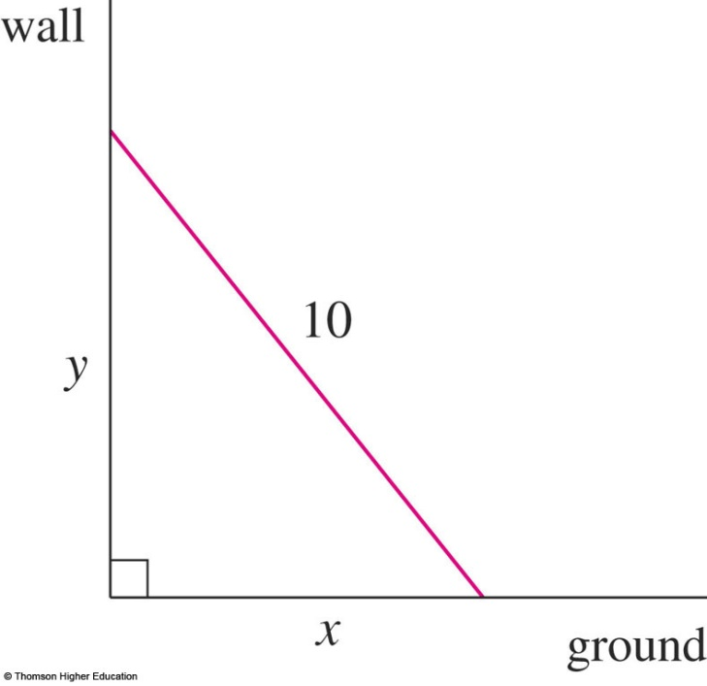
example
We first draw a diagram and label it as in the figure.
x: distance from the bottom of the ladder to the wall
y: distance from the top of the ladder to the ground.
Functions of time t: x(t), y(t)

Slide 38
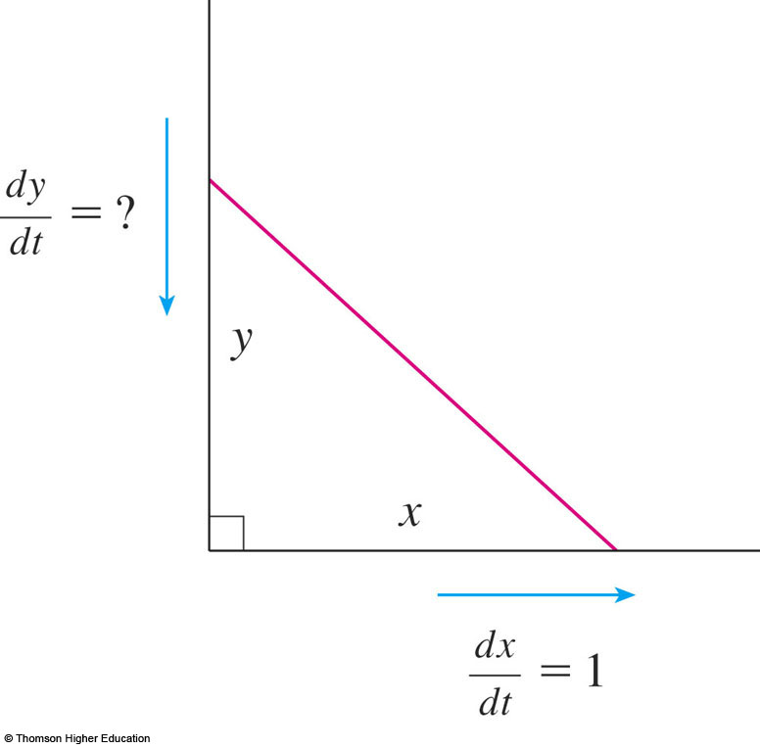
example
dx/dt = 1 ft/s Find dy/dt when x = 6 ft.

Slide 39
example
by the Pythagorean Theorem:
x² + y² = 100
[x(t)]² + [y(t)]² = 100

Slide 40
example
Differentiating each side with respect to t :
We obtain:

Slide 41
Do yourself
The top of a ladder slides down a vertical wall at a rate of 0.15 m/s. At the moment when the bottom of the ladder is 3 m from the wall, it slides away from the wall at a rate of 0.2 m/s. How long is the ladder?
Two sides of a triangle are 4 m and 5 m in length and the angle between them is increasing at a rate of 0.06 rad/s. Find the rate at which the area of the triangle is increasing when the angle between the sides of ﬁxed length is π/3.

Slide 42
Approximation by differentials
Differential: // vi phân
dy = f’(x)dx

Slide 43
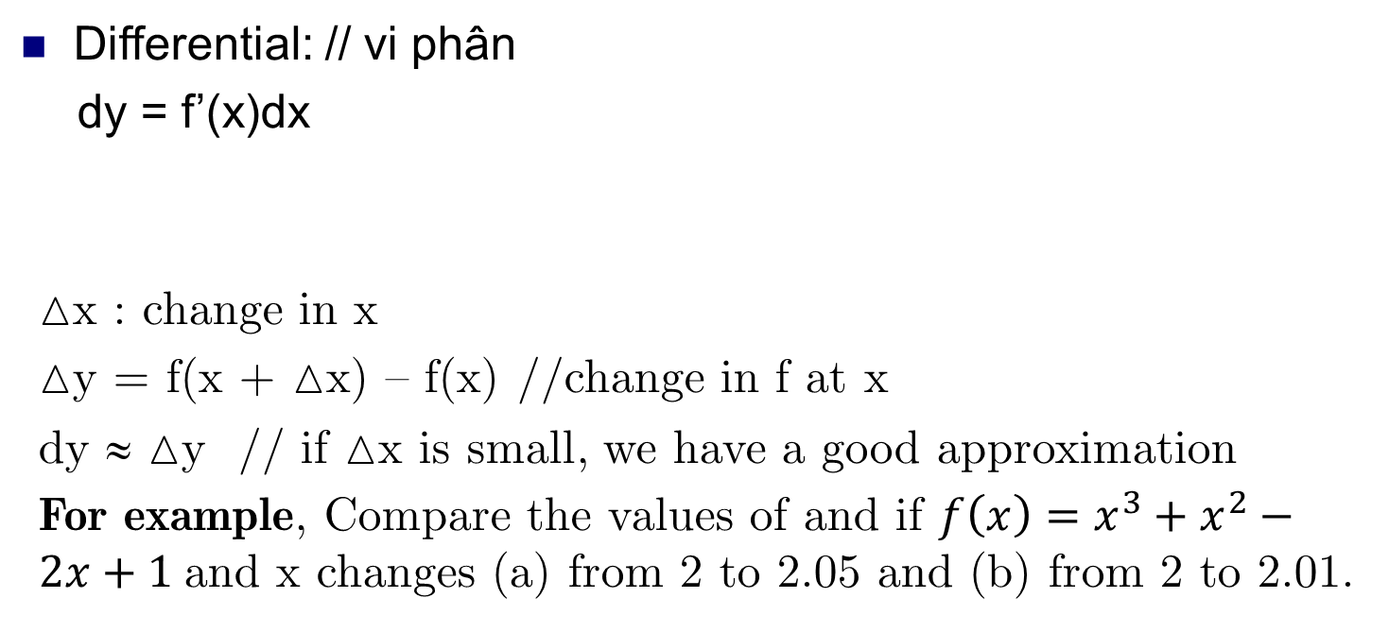
Approximation by differentials
Differential: // vi phân
dy = f’(x)dx
x : change in x
y = f(x + x) – f(x) //change in f at x
dy ≈ y // if x is small, we have a good approximation
For example, Compare the values of and if $f\left(x\right)=x^{3}+x^{2}−2x+1$and x changes (a) from 2 to 2.05 and (b) from 2 to 2.01.

Slide 45
DIFFERENTIALS
The radius of a sphere was measured and found to be 21 cm with a possible error in measurement of at most 0.05 cm.
What is the maximum error in using this value of the radius to compute the volume of the sphere?

Slide 46
DIFFERENTIALS
If the radius of the sphere is r, then its volume is V = 4/3πr³.
If the error in the measured value of r is denoted by dr = ∆r, then the corresponding error in the calculated value of V is ∆V.

Slide 47
DIFFERENTIALS
This can be approximated by the differential
dV = 4πr²dr
When r = 21 and dr = 0.05, this becomes:
dV = 4π(21)² 0.05 ≈ 277
The maximum error in the calculated volume is about 277 cm³.

Slide 48
Do yourself
Use differentials to estimate the amount of paint needed to apply a coat of paint 0.05 cm thick to a hemispherical dome with diameter 50 m.

Slide 49
Summary
Derivatives and slope of tangent lines
Definition of derivative
Symbols
Rules for computing derivatives
The chain rule

Slide 50
THANKS

